Slide 1

Design and Analysis of Algorithm
Department of Computer Science and Engineering

Slide 2
DAA Objectives & Outcomes
Course Objectives:
● Study the performance analysis of algorithms
● Select algorithmic strategies to solve given problem.
● Explore solution space to solve the problems.
● Provide the knowledge about complexity theory
Course Outcomes:
1. Analyze the algorithm complexity using asymptotic notations and describe the divide-and-conquer paradigm and recite algorithms that employ this paradigm.
2. Describe greedy and dynamic programming algorithmic strategies and analysis algorithms that employ this paradigm.
3. Illustrate the solution space using backtracking and branch and bound algorithmic techniques.
4. Describe the concept of complexity theory.
Course prerequisite
Data Structure II
C, C++, Java or other programming languages

Slide 3

Module I - Fundamentals of Algorithm
The Role of Algorithms in Computing Algorithmic specifications, Analyzing algorithm, asymptotic notations, order of growth
Algorithm design strategy, Divide and conquer - Merge Sort, Quick sort, Large Integer multiplication, solving recurrences
( substitution method & Master’s theorem )

Slide 4
Why Study this Course?
Donald E. Knuth stated “Computer Science is the study of algorithms”
Cornerstone of computer science. Programs will not exist without algorithms.
Algorithms are needed (most of which are novel) to solve the many problems listed here
Computational Primitives –CG –Geometric Algorithms
Communication Network –Shortest path Algorithms
Genome Structure in Bioinformatics –Dynamic Programming
Search engines –Page Rank Algorithm by Google
Challenging (i.e. Good for brain !!!)
Real Blend of Creativity and Precision
Very interesting if you can concentrate on this course
Notes:
But let me begin by justifying this course's existence. And giving you some reasons why you should be highly motivated to learn about algorithms.

Slide 5
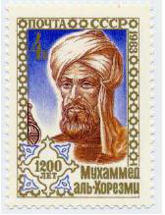
Algorithm: A brief History
The word algorithm comes from the name of Persian author, Abu Ja’far Mohammed ibn Musa al Khowarizmi (c. 825 A.D.), who wrote a textbook on mathematics.
The book was translated into Latin in the 12th century under the title Algoritmi de numero Indorum. This title means "Algoritmi on the numbers of the Indians", where "Algoritmi" was the translator's Latinization of Al-Khwarizmi's name.
Many centuries later, decimal system was adopted in Europe, and the procedures in Al Khwarizmi’s book were named after him as “Algorithms”.
Notes:
algorism

Slide 6
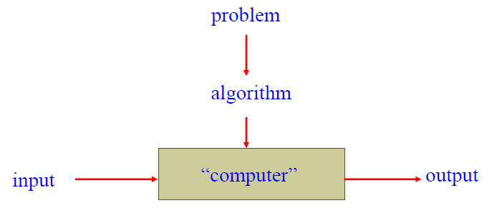
What is an Algorithm?
An algorithm is a sequence of unambiguous instructions for solving a computational problem i.e., for obtaining a required output for any legitimate input in a finite amount of time.
It is any well defined computational procedure that takes some value or set of values as input and produces some value, or set of values as output

Slide 7
Algorithm & its Properties
More precisely, An algorithm is a finite set of instructions that accomplishes a particular task.
Algorithm must satisfy the following properties:
Input
Valid inputs must be clearly specified.
Output
can be proved to produce the correct output given a valid input.
Finiteness
terminates after a finite number of steps
Definiteness
Each instruction must be clear and unambiguously specified
Effectiveness
Every instruction must be sufficiently simple and basic.

Slide 8
Examples of Algorithms – Computing the Greatest Common Divisor of Two Integers
Problem: Find gcd (m,n), the greatest common divisor of two nonnegative, not both zero integers m and n
//First try –School level algorithm:
Step1: factorize m.( m ← m1*m2*m3…)
Step2: factorize n. (n ← n1*n2*…)
Step 3: Identify common factors , multiply and return.

Slide 9
Pseudocode of Euclid’s Algorithm
Algorithm : Euclid (m, n)
//Computes gcd(m, n) by Euclid’s algorithm
//Input: Two non negative, not-both-zero integers m and n
//Output: Greatest common divisor of m and n gcd(m, n) = gcd(n, m mod n)
While (m does not divide n) do
r ← n mod m
n ← m
m ← r
return m
Questions:
Finiteness: how do we know that Euclid’s algorithm actually comes to a stop?
Definiteness: non-ambiguity
Effectiveness: effectively computable.
Which algorithm is faster, the Euclid’s or previous one?

Slide 10
Example of Euclid’s Algorithm
Simple Algorithm
m = 36, n = 48
m = 2 * 2 * 3 * 3
n = 2 * 2 * 2 * 2 * 3
Common factors
2, 2, 3
GCD = 12
9 divisions
Euclid Algorithm
36 divides 48
r = 48 mod 36
n = 36
m = 12
Return 12
2 divisions
Another example:
m = 434 and n = 966

Slide 11
Fundamentals of Algorithmic Problem Solving
Understanding the problem
Asking questions, do a few examples by hand, think about special cases, etc.
Deciding on
Exact vs. approximate problem solving
Appropriate data structure
Design an algorithm
Proving correctness
Analyzing an algorithm
Time efficiency : how fast the algorithm runs
Space efficiency: how much extra memory the algorithm needs.
Coding an algorithm

Slide 12
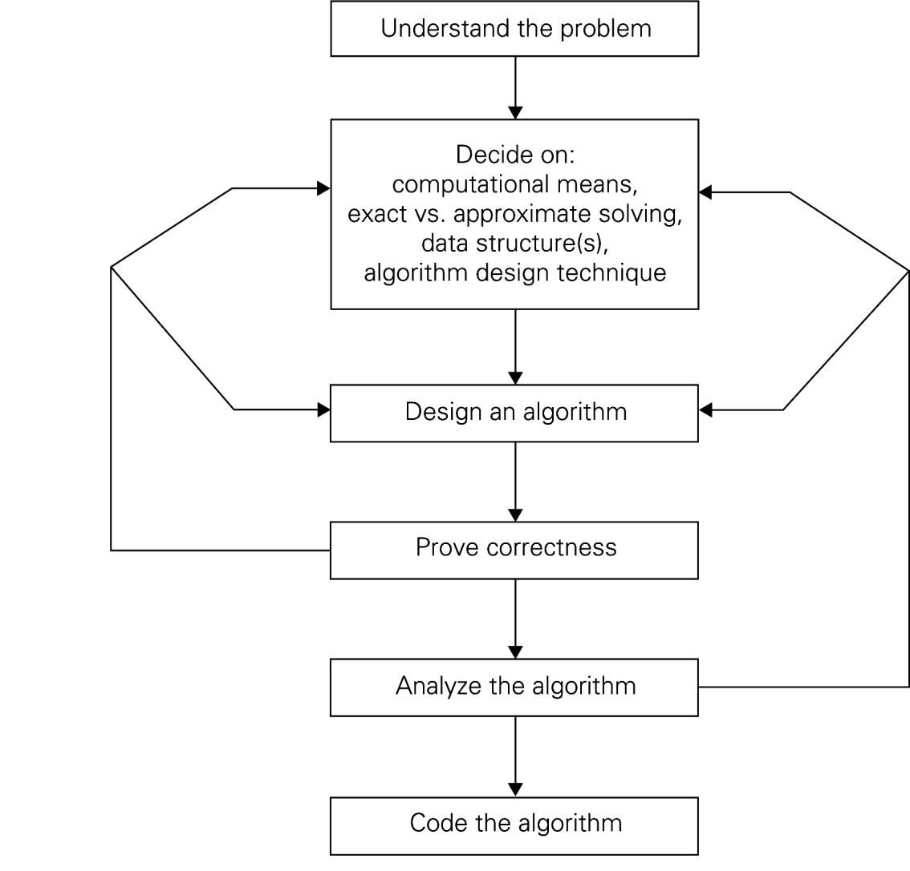
Algorithm Design and Analysis Process

Slide 13
Algorithms as a Technology
Even if computers were infinitely fast and memory was plentiful and free
Study of algorithms still important – still need to establish algorithm correctness
Since time and space resources are infinitely fast, any correct algorithm for solving a problem would do.
Real-world computers may be fast but not infinitely fast.
Memory is cheap but not free
Hence Computing time is bounded resource and so need space in memory.
We should use resources wisely by efficient algorithm in terms of space and time

Slide 14
Algorithm Efficiency
Time and space efficiency are the goal
Algorithms often differ dramatically in their efficiency
Example: Two sorting algorithms
INSERTION-SORT – time efficiency is c₁n²
MERGE-SORT – time efficiency is c₁nlogn
For which problem instances would one algorithm be preferable to the other?
For example,
A faster computer ‘A’ (10¹⁰ instructions/sec) running insertion sort against a slower computer ‘B’ (10⁷instructions/sec) running merge sort. Suppose that c1=2，c2=50 and n= 10⁷.
Notes:
C1 and c2 not depend on input size n

Slide 15
Efficiency
Machine A Insertion- Sort
Machine B Merge- Sort
Problem Size
n | 2n²/10⁹ | 50nlogn/10⁷
10,000 | 0.20 | 0.66
50,000 | 5.00 | 3.90
100,000 | 20.00 | 8.30
500,000 | 500.00 | 47.33
1,000,000 | 2,000.00 | 99.66
5,000,000 | 50,000.00 | 556.34
10,000,000 | 200,000.00 | 1,162.67
50,000,000 | 5,000,000.00 | 6,393.86

Slide 16
Methods of Specifying an Algorithm
Natural language
Ambiguous
Example : “Mike ate the sandwich on a bed.”
Flowchart
Graphic representations called flowcharts , only if the algorithm is small and simple.
Pseudocode
A mixture of a natural language and programming language-like structures
Precise and concise.
Pseudocode in this course
omits declarations of variables
use indentation to show the scope of such statements as for, if, and while.
use ← for assignment

Slide 17
Pseudocode Conventions
Comments begin with // and continue until the end of line.
Blocks are indicated with matching braces :{ and }. A compound statement (i.e., a collection of simple statements) can be represented as as a block. The body of a procedure also forms a block. Statements are delimited by;
Assignment of values to variables is done using the assignment statement
〈variable〉≔〈expression〉;
There are two Boolean values true and false. In order to produce these values,
Logical operators : and, or, and not
Relational operators<, ≤, =, ≠, ≥, and >
Elements of multidimensional arrays are accessed using [ and ]. Ex A[i,j]

Slide 18
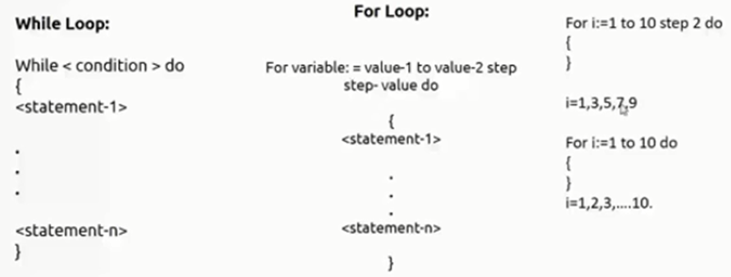
Pseudocode Conventions
Looping statement can be employed as follows :
( while, for , repeat-until )
A conditional statement has the following forms:
If 〈condition〉 then 〈statement〉
If 〈condition〉 then 〈statement 1〉 else 〈statement 2〉
We also employ the following case statement:
case
{
: 〈condition 1〉: 〈statement 1〉
.
: 〈condition n〉: 〈statement n〉
: else: 〈statement n + 1〉
}

Slide 19
Pseudocode Conventions
Ref Book Sahni
Input and output are done using the instructions read and write. No format is used to specify the size of input or output quantities.
An algorithm consists of a heading and a body. The heading takes the form
Algorithm Name (〈parameter list〉)
{
// body
}
Example : Algorithm to find and return the maximum of n given numbers:
Algorithm Max (A, n)
// A is an array of size n.
{
Result ≔A[1];
For i ≔2 to n do
If A[i] > Result then Result ≔A[i];
Return Result;
}

Slide 20
Analysis of Algorithms
Two main issues related to algorithms
How to design algorithms
How to analyze algorithm efficiency
Analysis of Algorithms
How good is the algorithm?
time efficiency
space efficiency
Does there exist a better algorithm?
lower bounds
optimality

Slide 21
Common Rates of Growth
Let n be the size of input to an algorithm, and k some constant. The following are common rates of growth.
Constant: Θ(k), for example Θ(1)
Linear: Θ(n)
Logarithmic: Θ(log_{k} n)
Linear : n Θ(n) or n log n: Θ(n log_{k} n)
Quadratic: Θ(n² )
Polynomial: Θ(n^{k} )
Exponential: Θ(k^{n})

Slide 22
Why Analyse?
Practical reasons:
Resources are scarce
Greed to do more with less
Avoid performance bugs
Core Issues:
Predict performance
How much time does binary search take?
Compare algorithms
How quick is Quicksort?
Provide guarantees
Size not with standing, Red-Black tree inserts in O(log n)
Understand theoretical basis
Sorting by comparison cannot do better than (n log n)

Slide 23
What to analyse?
Ref Book: NPTEL
Ref Book: NPTEL
Core Issue: Cannot control what we cannot measure
Time
The time complexity, T(n), taken by a program P is the sum of the running times for each statement executed
Space
The space complexity of a program is the amount of memory that it needs to run to completion
Examples : Sum of Natural Numbers
// Sum of Natural Numbers
Algorithm sum (a, n)
{
s := 0 ;
For i := 1 to n do
s := s + a[i];
return s;
}
Time T(n) = n (additions)
Space S(n) = 2 (n, s)
Notes:
Whatever can be measured that we want to analyze

Slide 24
Tabular Method
Ref Book Sahni
Iterative function to sum a list of numbers (steps/execution )
Machine Model: Random Access Machine (RAM) Computing Model
Input data & size
Operations
Intermediate Stages
Output data & size

Slide 25
Asymptotic Analysis
Core Idea: Cannot compare actual times; hence compare Growth or how time increases with input
O notation (“Big Oh”)
Ω notation (Omega)
Θ notation (Theta)
o notation (Little oh)
ω notation (Little omega)

Slide 26
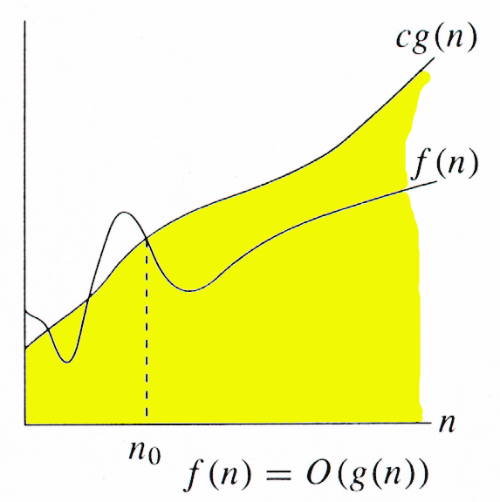
ASYMPTOTICS NOTATIONS O-notation (Big Oh)
Asymptotic Upper Bound
For a given function g(n), we denote O(g(n)) as the set of
functions:
O(g(n)) = { f(n)| there exists positive constants c and n0
such that 0 ≤ f(n) ≤ c g(n) for all n ≥ n0 }
It is used to represent the worst case growth of an algorithm
in time or a data structure in space when they are
dependent on n, where n is big enough
Example :

Slide 27
Big Oh - Example
f(n) = n²+ 5n = O(n2)
g(n) = n² ……… c = 2
n n²+ 5n 2n²
1 5 2
2 14 8
5 50 50
f(n) <= c g(n) for all n> = n₀ where c=2 & n₀ =5

Slide 28
Big Oh - Example
Let f(N) = 2N². Then
f(N) = O(N⁴) (loose bound)
f(N) = O(N³) (loose bound)
f(N) = O(N²) (It is the best answer and the bound is asymptotically tight.)
O(N²): reads “order N-squared” or “Big-Oh N-squared”.

Slide 29
Big Oh - Example
Prove that if T(n) = 15n³ + n² + 4, T(n) = O(n³).
Proof.
Let c = 20 and n₀ = 1.
Must show that 0 ≤ f (n) and f (n) ≤ cg(n).
0≤15n³ + n² + 4 for all n ≥ n₀ = 1.
f (n) = 15n³ + n² + 4 ≤ 20n³ (20g(n) = cg(n))
As per defination of Big O, hence T(n) = O(n³)

Slide 30
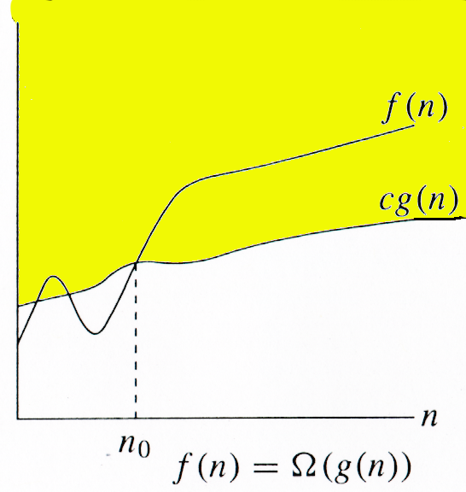
ASYMPTOTICS NOTATIONS Ω-notation
Asymptotic lower bound
Ω (g(n)) represents a set of functions such that:
Ω(g(n)) = {f(n): there exist positive
constants c and n0 such that
0 ≤ c g(n) ≤ f(n) for all n≥ n0}

Slide 31
Big Omega - Example
Example 1 :
f(n) = n²+ 5n
g(n) = n² ……… c = 1
n n²+ 5n c*n²
¹ ⁵ ¹
2 14 4
5 50 25
f(n) >= c g(n) for all n> = n₀ where c=1 & n₀ =1
Example 1 :
Prove that if T(n) = 15n³ + n² + 4, T(n) = Ω (n³).
Proof.
Let c = 15 and n₀ = 1.
Must show that 0 ≤ cg(n) and cg(n) ≤ f (n).
0 ≤ 15n³ for all n ≥ n₀ = 1.
cg(n) = 15n³ ≤ 15n³ + n² + 4 = f (n)

Slide 32
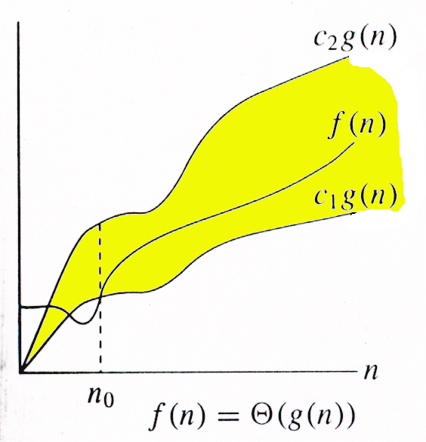
ASYMPTOTICS NOTATIONS Θ-notation
Asymptotic tight bound
Θ (g(n)) represents a set of functions such that:
Θ (g(n)) = {f(n): there exist positive
constants c1, c2, and n0such
that 0 ≤ c1g(n) ≤ f(n) ≤ c2g(n)
for all n≥ n0 }

Slide 33
Theta Example
f(N) = Θ(g(N)) iff f(N) = O(g(N)) and f(N) = Ω(g(N))
It can be read as “f(N) has order exactly g(N)”.
The growth rate of f(N) equals the growth rate of g(N). The
growth rate of f(N) is the same as the growth rate of g(N)
for large N.
Theta means the bound is the tightest possible.
If T(N) is a polynomial of degree k, T(N) = Θ(N^{k}).
For logarithmic functions, T(log_{m} N) = Θ(log N).

Slide 34
o notation (Little oh)
The function f(n) = o(g(n)) iff
o(g(n)) = {f(n): ∀ c > 0, ∃ n₀ > 0 such that ∀ n ≥ n₀, we have 0 ≤ f(n) < cg(n)}.
Example: The function 3n + 2 = o(n²) as

Slide 35
ω notation (Little omega)
The function f(n) = ω(g(n)) iff
ω(g(n)) = {f(n): ∀ c > 0, ∃ n₀ > 0 such that ∀ n ≥ n₀, we have 0 ≤ cg(n) < f(n)}.

Slide 36
Asymptotic Notations
It is a way to compare “sizes” of functions
O-notation ------------------Less than equal to (“≤”)
Θ-notation ------------------Equal to (“=“)
Ω-notation ------------------Greater than equal to (“≥”)
O ≈ ≤
Ω ≈ ≥
Θ ≈ =
o ≈ <
ω ≈ >

Slide 37
Examples On Asymptotic Notations
Explain How is f(x) = 4n^2 – 5n + 3 is O(n^2)
Show that
30n+8 is O(n)
100n + 5 ≠ Ω(n²)
5n² = Ω(n)
100n + 5 = O(n²)
n²/2 –n/2 = Θ(n²)

Slide 38
Algorithm Design Techniques/Strategies
Brute force
Divide and conquer
Space and time tradeoffs
Greedy approach
Dynamic programming
Backtracking
Branch and bound

Slide 39
Divide & Conquer
Control Abstraction
DANDC (P)
{
if SMALL (P) then return S (p);
else
{
divide p into smaller instances p1, p2, …. Pk, k >= 1;
apply DANDC to each of these sub problems;
return (COMBINE (DANDC (p1) , DANDC (p2),…., DANDC (pk));
}
}
Divide the problem into smaller sub problems
Conquer the sub problems by solving them recursively.
Combine the solutions to the sub problems into the solution of the original problem.
Notes:
sahani

Slide 40
Divide-and-Conquer Technique (cont.)
a problem of size n
(instance)
subproblem 1
of size n/2
subproblem 2
of size n/2
a solution to
subproblem 1
a solution to
subproblem 2
a solution to
the original problem
It general leads to a recursive algorithm!
Notes:
A levitin

Slide 41
Time complexity of the general algorithm
A Recurrence is an equation or inequality that describes a function in terms of its value on smaller inputs
Special techniques are required to analyze the space and time required
Time complexity (recurrence relation):
where D(n) : time for splitting
C(n) : time for conquer
c : a constant

Slide 42
Methods for Solving recurrences
Substitution Method
We guess a bound and then use mathematical induction to prove our guess correct.
Recursion Tree
Convert recurrence into tree
Master Method

Slide 43
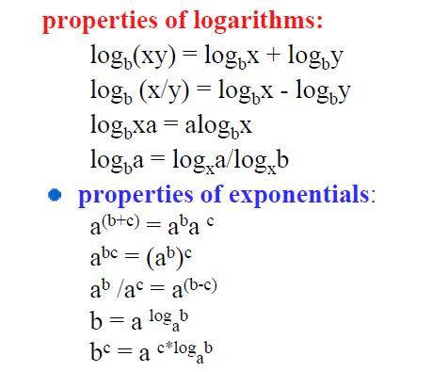
Math You need to Review

Slide 44
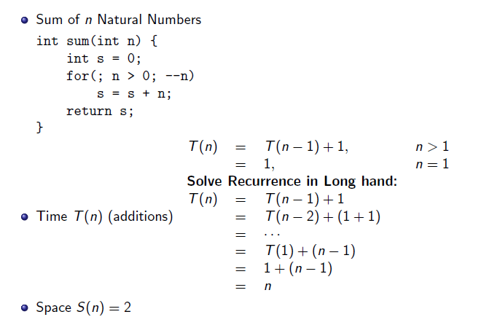
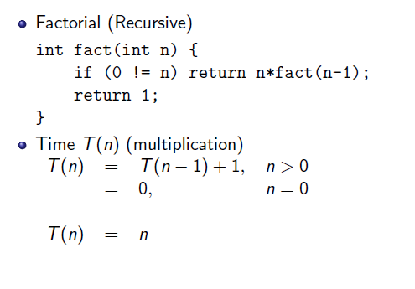
Substitution Method

Slide 45
Quick Sort

Slide 46
Binary Search

Slide 47
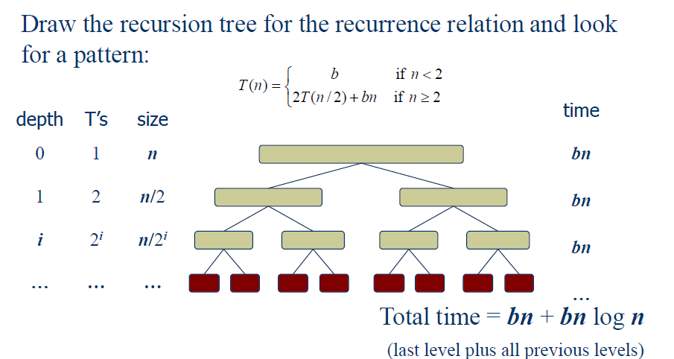
The Recursion Tree

Slide 48
Master Theorem
Master method provides a “cookbook” method for solving recurrences of the following form
T(n) = a T(n/b) + f(n)
where a ≥ 1, b > 1. If f(n) is asymptotically positive function. T(n) has following asymptotic bounds:
There are 3 cases:

Slide 49
Example of Master Method
To use the master theorem, we simply plug the numbers into the formula

Slide 50
Master Method (Simplified)
Let T(n) be a monotonically increasing function that satisfies
T(n) = a T(n/b) + f(n)
T(1) = c
where a ≥ 1, b ≥ 2, c>0. If f(n) is Θ(n^{d}) where d ≥ 0 then solution to recurrence relation is given as
Case 1: T(n) ϵ if a < b^{d}
Case 2: T(n) ϵ if a = b^{d}
Case 3: T(n) ϵ if a > b^{d}

Slide 51
Divide-and-Conquer Examples
Sorting : Mergesort and Quicksort
Binary tree traversals
Binary search
Multiplication of large integers
Matrix multiplication: Strassen’s algorithm
Closest-pair and convex-hull algorithms
Notes:
A levitin

Slide 52
Mergesort
Merge sort is a divide and conquer algorithm for sorting arrays. To sort an array, first you split it into two arrays of roughly equal size. Then sort each of those arrays using merge sort, and merge the two sorted arrays.

Slide 53
Pseudocode of Merge-Sort (A, p, r)
INPUT: a sequence of n numbers stored in array A
OUTPUT: an ordered sequence of n numbers
MergeSort (A, p, r) // sort A[p..r] by divide & conquer
if p < r
then q ← ⎣(p+r)/2⎦
MergeSort (A, p, q)
MergeSort (A, q+1, r)
Merge (A, p, q, r) // merges A[p..q] with A[q+1..r]
Initial Call: MergeSort(A, 1, n)

Slide 54
Procedure Merge
Merge(A, p, q, r)
1 n₁ ← q – p + 1
2 n₂ ← r – q
for i ← 1 to n₁
do L[i] ← A[p + i – 1]
for j ← 1 to n₂
do R[j] ← A[q + j]
L[n₁+1] ← ∞
R[n₂+1] ← ∞
i ← 1
j ← 1
for k ←p to r
do if L[i] ≤ R[j]
then A[k] ← L[i]
i ← i + 1
else A[k] ← R[j]
j ← j + 1
Input: Array containing sorted subarrays A[p..q] and A[q+1..r].
Output: Merged sorted subarray in A[p..r].
Sentinels, to avoid having to
check if either subarray is
fully copied at each step.

Slide 55
Analysis of Mergesort
Running time T(n) of Merge Sort:
Divide: computing the middle takes Θ(1)
Conquer: solving 2 sub problems takes 2T(n/2)
Combine: merging n elements takes Θ(n)
Total:
T(n) = Θ(1) if n = 1
T(n) = 2T(n/2) + Θ(n) if n > 1
T(n) = Θ(n lg n)
Space requirement: Θ(n) (not in-place)
Notes:
even if not analyzing in detail, show the recurrence for mergesort in worst case:
T(n) = 2 T(n/2) + (n-1)
worst case comparisons for merge

Slide 56
Recursion Tree for Merge Sort
Ref Book: Thomas Cormen
For the original problem, we have a cost of cn, plus two subproblems each of size (n/2) and running time T(n/2).
Each of the size n/2 problems has a cost of cn/2 plus two subproblems, each costing T(n/4).
cn
cn
Cost of divide and merge.
cn/2
cn/2
T(n/2)
T(n/2)
T(n/4)
T(n/4)
T(n/4)
T(n/4)
Cost of sorting subproblems.

Slide 57
Recursion Tree for Merge Sort
Ref Book: Thomas Cormen
Continue expanding until the problem size reduces to 1.
cn
cn
cn/2
cn/2
cn
lg n
cn/4
cn/4
cn/4
cn/4
cn
c
c
c
c
c
c
cn
Total : cnlgn+cn

Slide 58
Recursion Tree for Merge Sort
Ref Book: Thomas Cormen
Continue expanding until the problem size reduces to 1.
cn
Each level has total cost cn.
Each time we go down one level, the number of subproblems doubles, but the cost per subproblem halves ⇒ cost per level remains the same.
There are lg n + 1 levels, height is lg n. (Assuming n is a power of 2.)
Can be proved by induction.
Total cost = sum of costs at each level = (lg n + 1)cn = cnlgn + cn = Θ(n lgn).
cn/2
cn/2
cn/4
cn/4
cn/4
cn/4
c
c
c
c
c
c

Slide 59
Quicksort
Ref Book: Thomas Cormen
A
Divide :
Pick any element (pivot) v in array A[p…r]
Partition array A into two groups
A1[p - - -q-1] , A2 [q+1----r] Compute the index q
A1 element < A[q] < A2 element
Conquer step: recursively sort A1 and A2
Combine step: the sorted A1 (by the time returned from recursion), followed by A[q], followed by the sorted A2 (i.e., nothing extra needs to be done)
v
v
A1
A2

Slide 60
Idea of Quick Sort
Ref Book: Internet
1) Select: pick an element
2) Divide: rearrange elements so that x goes to its final position E
3) Recurse and Conquer: recursively sort

Slide 61
Quicksort Pseudo-code
INPUT: a sequence of n numbers stored in array A
OUTPUT: an ordered sequence of n numbers
QuickSort (A, p, r) // sort A[p..r] by divide & conquer
if p < r
then q = Partition (A, p, r)
QuickSort (A, p, q-1)
QuickSort (A, q+1, r)
Initial Call: QuickSort(A, 1, n)

Slide 62
Procedure Partitioning the array
Input: Array containing sorted subarrays A[p..q] and A[q+1..r].
Output: sorted subarray in A[p..r].
Partition(A, p, r)
1 x = A[r]
2 i = p - 1
for j ← p to r-1
if A[j] ≤ x
i= i +1
exchange A[i] with A[j]
exchange A[i] with A[j]
Return i + 1

Slide 63
The steps of QuickSort
S
select pivot value
81
43
31
57
13
75
92
0
65
26
S₁
S₂
partition S
0
31
75
13
43
65
92
81
26
57
S₁
S₂
QuickSort(S₁) and
QuickSort(S₂)
0
13
26
31
43
57
65
75
81
92
S
0
13
26
31
43
57
65
75
81
92
Voila! S is sorted

Slide 64
Quicksort Analysis
Assumptions:
A random pivot (no median-of-three partitioning)
No cutoff for small arrays
Running time
pivot selection: constant time, i.e. O(1)
partitioning: linear time, i.e. O(N)
running time of the two recursive calls
T(N)=T(i)+T(N-i-1)+cN where c is a constant
i: number of elements in S1

Slide 65
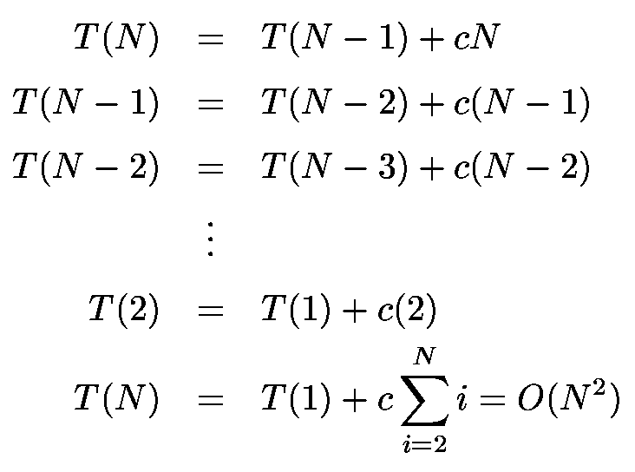
Worst-Case Analysis
worst case Partition?
The pivot is the smallest element, all the time
Partition is always unbalanced

Slide 66
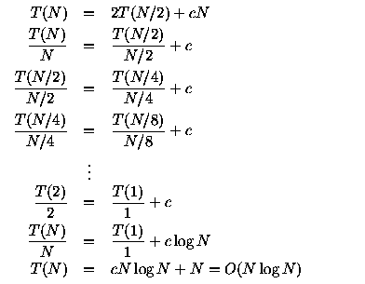
Best-case Analysis
best case Partitioning?
Partition is perfectly balanced.
Pivot is always in the middle (median of the array)

Slide 67
Average-Case Analysis
Intution for Average Case
On average, the running time is O(N log N)

Slide 68
Summary Analysis of Quicksort
Best case: split in the middle — Θ(n log n)
Worst case: sorted array! — Θ(n²)
Average case: random arrays — Θ(n log n)
Improvements:
better pivot selection: median of three partitioning
switch to insertion sort on small subfiles
elimination of recursion

Slide 69
Large Integer multiplication

Slide 70
References
Thomas H Cormen and Charles E.L Leiserson, "Introduction to Algorithm" PHI Third Edition
Horowitz and Sahani, "Fundamentals of Computer Algorithms", 2ND Edition. University Press, ISBN: 978 81 7371 6126, 81 7371 61262.

